Slide 1
Creating a Great PowerPoint presentation

Slide 2
Organize thoughts
Use View/Outline View
Don’t type on the screen
Use tab and shift tab
Use Alt * Ctrl and Arrow keys
Max five lines per page
Notes:
Change the View / Outline View
Group all files that end with * under the preceding heading

Slide 3
Three Learning Styles
Notes:
The do Ctrl H to find * and replace with nothing

Slide 4
Auditory*

Slide 5
Visual*

Slide 6
Kinesthetic*

Slide 7
Types of Content

Slide 8
Text*

Slide 9
Pictures*

Slide 10
Video*

Slide 11
Smart Art*

Slide 12
Table*

Slide 13
Charts*

Slide 14
Text
Bullets
Sub bullets
Max of 6

Slide 15
Pictures
Pictures from Insert tab
Try Stock, web or on computer
Resize from corner
Try holding Ctrl
Move with four-sided arrow
Try holding Shift
Right click for options
Layer Pictures
Picture Format toolbar options
Try Compress pictures
Try various picture frames

Slide 16
Video
Go to Insert tab
Copy this url https://youtu.be/QRg5PGNmLA0?si=TQ3wG8AnOSsG4SjH
Go Insert a video
Online video
Resize the video
Delete this text if you wish

Slide 17
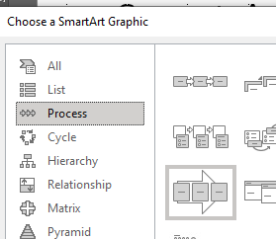
Smart Art
First copy all these bullets
Insert Smart Art
Select Process
Continuous Block
Paste Into text box
Delete this text box
Format the Smart Art
Colors
Shapes

Slide 18
Table
Name | Dept | Ext | Email

Slide 19
Charts
Select chart
Right click to edit data

Slide 20
Movement

Slide 21
Transitions*

Slide 22
Animation*

Slide 23
Notes

Slide 24
Chart*

Slide 25
Chart Animation options*
Animations /Wipe
In Animation Pane choose Effect Options
Chart Animation
Don’t animate chart
One series at a time

Slide 26
Design
Switch to normal view
Select Design
Then Select Design/Designer
Only one slide at a time

Slide 27
Notes

Slide 28
Speaker*
Add below the slide graphic

Slide 29
Paper notes*

Slide 30
Audience*
View/Handout Master

Slide 31
Speaker*
View/Notes Master

Slide 32
Getting ready for the Presentation
Record Timing
Slide show/Record timings
Notice total time and time per slide

Slide 33
Editing Timing
Slide sorter view
first and last
Others
“Just In Case” slides
Notes:
Slide sorter view
None on first and last
Others where you might pause
Using “Just In Case” slides

Slide 34
Creating a Custom Show
Under “Slide Show” ribbon click on Custom show
Name the new presentation
Pick the slide you want
Change the order if you like
Notes:
Slide sorter view
None on first and last
Others where you might pause
Using “Just In Case” slides

Slide 35
Frank’s Favourites keyboard shortcuts
S for stop and start
W or B for white or black
Ctrl P for pen
Ctrl A for arrow
Ctrl H to hide
F5 to start
Any number and enter takes you to that slide
H shows a hidden slide

Slide 36
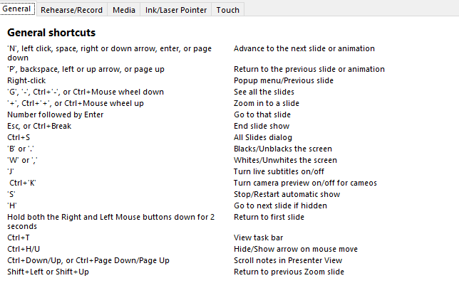
Keyboard shortcuts
F1 for help

Slide 37
Presentation Tips
Less is best
One step at a time
Talk to the audience
Use the screen highlights
Notes:
Less is best. Viewer word. Just hooks. They should be listening to you
One step at a time. Keep the audience at the same place as you
Talk to the audience. NOT to the screen
Use the screen highlight tools
Use timings to free you up and keep you on pace

Slide 38
Thank you for joining
Reach out any time to PowerConcepts.ca
FrankByl@PowerConcepts.ca

